Slide 1
Intelligent Agents
Chapter 2

Slide 2
Recap: intelligence?
Q. Yes, but what is intelligence?
A. Intelligence is the computational part of the ability to achieve goals in the world. Varying kinds and degrees of intelligence occur in people, many animals and some
machines
http://www-formal.stanford.edu/jmc/whatisai/
Courtesy Tim Finin

Slide 3
Okay, but really? What is AI?
“Artificial intelligence, or AI, is the field that studies the synthesis and analysis of computational agents that act intelligently.” --Poole & Mackworth
something that acts in an environment; it does something.
Makes appropriate actions for circumstances & goals
Balances short & long-term goals appropriately
Flexible & reactive
Learns/recognizes patterns
Aware of computational/task budgets & limitations
Use “computation” to explain and traceback the actions
Courtesy Frank Ferraro

Slide 4
Possible AI approaches
Like humans
Well
Think
Act

Slide 5
Possible approaches
Like humans
Well
Rational
agents
Think
GPS
AI tends to work mostly in this area
Act
Heuristic
systems
Eliza

Slide 6
Think well
Like
humans
Well
Develop formal models of
knowledge representation, reasoning, learning, memory, problem solving, that can be rendered in algorithms
Often an emphasis on systems that are provably correct, and guarantee finding an optimal solution
 | Rational agents
 | Heuristic systems
Think
Act
Courtesy Tim Finin

Slide 7
Like
humans
Act well
Like
humans
Well
For a given set of inputs, generate output that’s not necessarily correct but gets job done
A heuristic (heuristic rule, heuristic method) is a rule of thumb, strategy, trick or simplification which drastically limits search for solutions in large problem spaces
 | Rational agents
 | Heuristic systems
Think
Act
Courtesy Tim Finin

Slide 8
Agents and AI
Much of our text is organized around the concept of autonomous agents
It defines an agent as
“anything that can be viewed as perceiving its environment through sensors and acting upon that environment through actuators”
Not all AI problems or tasks need or fit this concept, but it’s quite general

Slide 9
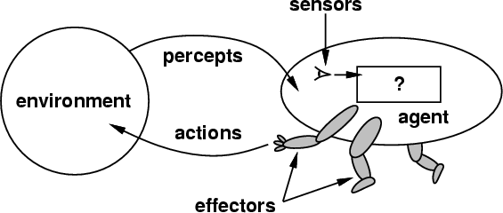
How do you design an intelligent agent?
Intelligent agents perceive environment via sensors and act rationally on them with their effectors
General properties
Reactive to the environment
Pro-active or goal-directed
Interacts with other agents through communication or via the environment
Autonomous

Slide 10
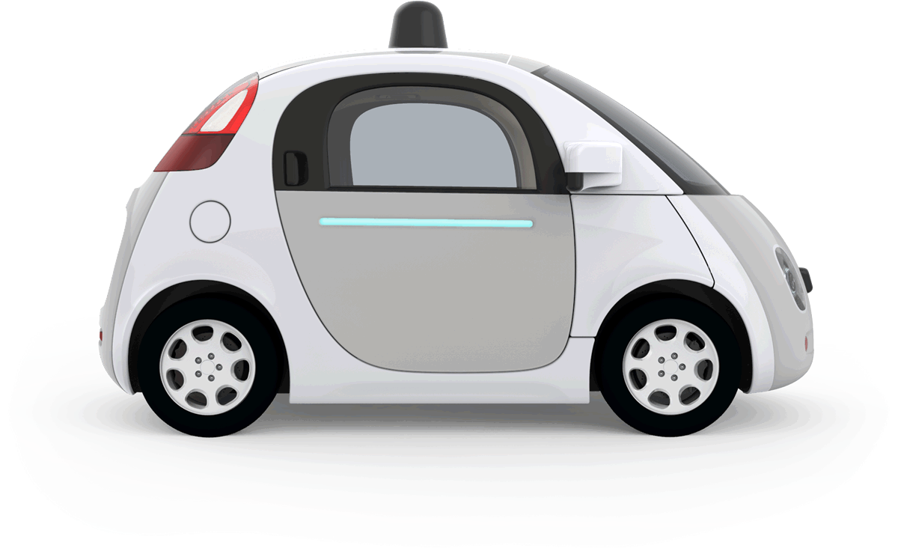
Example: autonomous taxi
Percepts: Video, sonar, speedometer, odometer, engine sensors, keyboard input, microphone, GPS, …
Actions: Steer, accelerate, brake, horn, speak, …
Goals: Maintain safety, reach destination, maximize profits (fuel, tire wear), obey laws, provide passenger comfort, …
Environment: U.S. urban streets, freeways, traffic, pedestrians, weather, customers, …
Different aspects of driving may require different types of agent programs!

Slide 11
Rationality
Ideal rational agents should, for each input, act to maximize expected performance measure based on
(1) percept sequence, and
(2) its built-in and acquired knowledge
Rationality → Need a performance measure to say how well a task has been achieved
Types of performance measures: false alarm (false positive) & false dismissal (false negative) rates, speed, resources required, effect on environment, money earned, …
Notes:
Consider measuring the performance of a airport TSA check point: its more important to minimize false negatives than false positives
When choosing a mate, it might be reversed

Slide 12
Information and learning
Rational agents aren’t expected to know everything
But to use what they do know effectively
Rationality includes information gathering -- If you don’t know something that might be useful, find out!
Rationality also can exploit learning – making generalization from past experience to fill in missing information

Slide 13

Autonomy
A system is autonomous to extent that its behavior is determined by its experience
A system isn’t autonomous if guided by its designer according to a priori decisions
An autonomous agent can always say “no”
To survive, agents must have:
Enough built-in knowledge to survive
The ability to learn
Courtesy Tim Finin

Slide 14
Some agent types
simple
(0) Table-driven agents
Use percept sequence/action table to find next action. Implemented by a lookup table
(1) Simple reflex agents
Based on condition-action rules, stateless devices with no memory of past world states
(2) Agents with memory
have represent states and keep track of past world states
(3) Agents with goals
Have a state and goal information describing desirable situations;
can take future events into consideration
(4) Utility-based agents
base decisions on utility theory in order to act rationally
complex
Courtesy Tim Finin

Slide 15
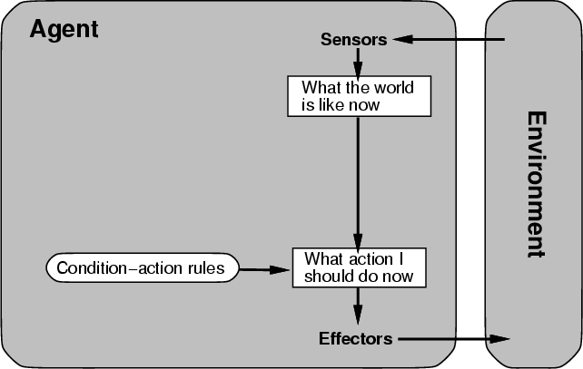
(0/1) Table-driven/reflex agent architecture
Use percept sequence/action table to find the next action. Implemented by a (large) lookup table
Courtesy Tim Finin

Slide 16
(0) Table-driven agents
Table lookup of percept-action pairs mapping from every possible perceived state to optimal action for it
Problems:
– Too big to generate and to store (e.g., chess has about 10¹²⁰ states)
– No knowledge of non-perceptual parts of the current state (e.g., desirability)
– Not adaptive to changes in the environment; entire table must be updated if changes occur
– Looping: Can’t make actions conditional on previous actions/states
Courtesy Tim Finin

Slide 17
(1) Simple reflex agents
Rule-based reasoning maps percepts to optimal action; each rule handles collection of perceived states (aka reactive agents)
Problems
– Still usually too big to generate and to store
– Still no knowledge of non-perceptual parts of state
– Still not adaptive to changes in environment; collection of rules must be updated if changes occur
– Still can’t condition actions on previous state
– Difficult to engineer if the number of rules is large due to conflicts
Courtesy Tim Finin

Slide 18
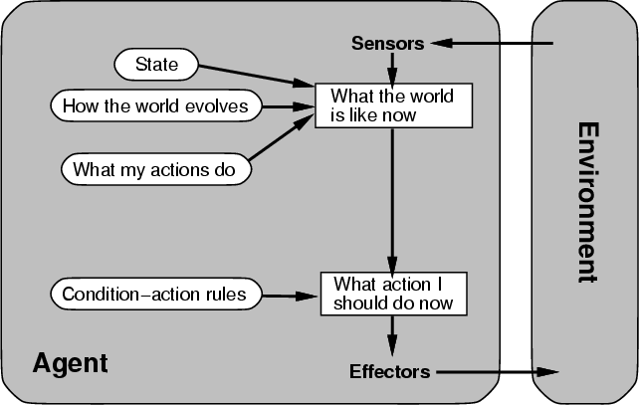
(2) Architecture for an agent with memory
internal state used to keep track of past states of the world
Courtesy Tim Finin

Slide 19
(2) Agents with memory
Encode internal state of world to remember past as contained in earlier percepts
Note: sensors don’t usually give entire world state at each input, so environment perception is captured over time
State used to encode different "world states" that generate the same immediate percept
Requires representing change in the world
Might represent just latest state, but then can’t reason about hypothetical courses of action
Courtesy Tim Finin

Slide 20
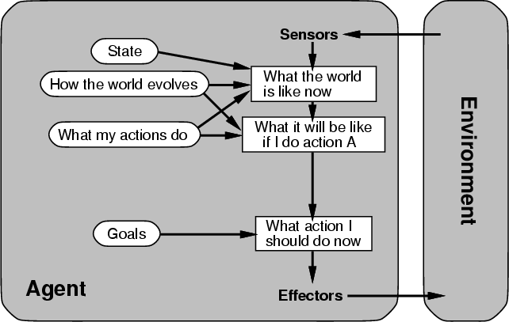
(3) Architecture for goal-based agent
state and goal information describe desirable situations allowing agent to take future events into consideration
Courtesy Tim Finin

Slide 21
(3) Goal-based agents
Deliberative instead of reactive
Choose actions to achieve a goal
Goal: description of a desirable situation
Keeping track of current state often not enough; must add goals to decide which situations are good
Achieving goal may require an action sequence
Model action consequences: “what happens if I do...?”
Use planning algorithms to produce action sequences
Courtesy Tim Finin

Slide 22
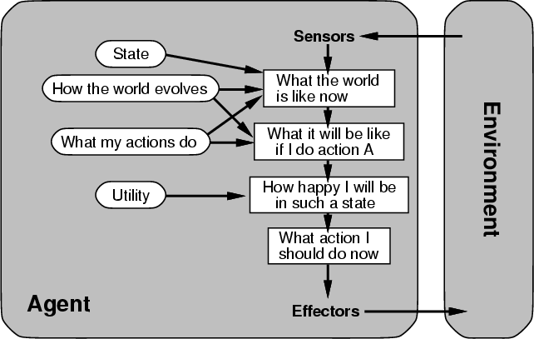
(4) Complete utility-based agent
base decisions on utility theory in order to act rationally
Courtesy Tim Finin

Slide 23
(4) Utility-based agents
For multiple possible alternatives, how to decide which is best?
Goals give a crude distinction between happy and unhappy states, but often need a performance measure for degree
Utility function U: State→Reals gives measure of success/happiness for given state
Allows decisions comparing choices between conflicting goals and likelihood of success and importance of goal (if achievement uncertain)
Courtesy Tim Finin

Slide 24
Properties of Environments
Observability: Full vs. Partial
Certainty: Deterministic vs. Stochastic Atomicity: Episodic vs. Sequential
Malleability: Static vs. Dynamic
Percept & Action Type: Discrete vs. Continuous
Number of Participants: Single agent vs. multi-agent
Courtesy Tim Finin

Slide 25
Properties of Environments
Fully/Partially observable
Agent’s sensors give complete state of environment needed to choose action: environment is fully observable
Such environments are convenient, freeing agents from keeping track of the environment’s changes
Deterministic/Stochastic
Environment is deterministic if next state is completely determined by current state and agent’s action
Stochastic (i.e., non-deterministic) environments have multiple, unpredictable outcomes
Courtesy Tim Finin

Slide 26
Properties of Environments
Episodic/Sequential
In episodic environments subsequent episodes don’t
depend on actions in previous episodes
In sequential environments agent engages in a series of connected episodes
Episodic environments don’t require agent to plan ahead
Static/Dynamic
Static environments doesn’t change as agent is thinking
The passage of time as agent deliberates is irrelevant
The agent needn’t observe world during deliberation
Courtesy Tim Finin

Slide 27
Properties of Environments
Discrete/Continuous
– If number of distinct percepts and actions is limited (or representable by an integer), environment is discrete, otherwise it’s continuous
Single agent/Multiagent
– In environments with other agents, agent must consider strategic, game-theoretic aspects of environment (for either cooperative or competitive agents)
– Many engineering environments don’t have multiagent properties, whereas most social and economic systems get their complexity from interactions of (more or less) rational agents
Courtesy Tim Finin

Slide 28
Characteristics of environments
 | Fully observable? | Deterministic? | Episodic? | Static? | Discrete? | Single agent?
Solitaire
Backgammon
Taxi driving
Internet shopping
Medical diagnosis
A Yes in a cell means that aspect is simpler; a No more complex
Courtesy Tim Finin

Slide 29
Characteristics of environments
 | Fully observable? | Deterministic? | Episodic? | Static? | Discrete? | Single agent?
Solitaire | No | Yes | Yes | Yes | Yes | Yes
Backgammon
Taxi driving
Internet shopping
Medical diagnosis
A Yes in a cell means that aspect is simpler; a No more complex
Courtesy Tim Finin

Slide 30
Characteristics of environments
 | Fully observable? | Deterministic? | Episodic? | Static? | Discrete? | Single agent?
Solitaire | No | Yes | Yes | Yes | Yes | Yes
Backgammon | Yes | No | No | Yes | Yes | No
Taxi driving
Internet shopping
Medical diagnosis
A Yes in a cell means that aspect is simpler; a No more complex
Courtesy Tim Finin

Slide 31
Characteristics of environments
 | Fully observable? | Deterministic? | Episodic? | Static? | Discrete? | Single agent?
Solitaire | No | Yes | Yes | Yes | Yes | Yes
Backgammon | Yes | No | No | Yes | Yes | No
Taxi driving | No | No | No | No | No | No
Internet shopping
Medical diagnosis
A Yes in a cell means that aspect is simpler; a No more complex
Courtesy Tim Finin

Slide 32
Characteristics of environments
 | Fully observable? | Deterministic? | Episodic? | Static? | Discrete? | Single agent?
Solitaire | No | Yes | Yes | Yes | Yes | Yes
Backgammon | Yes | No | No | Yes | Yes | No
Taxi driving | No | No | No | No | No | No
Internet shopping | No | No | No | No | Yes | No
Medical diagnosis
A Yes in a cell means that aspect is simpler; a No more complex
Courtesy Tim Finin

Slide 33
Characteristics of environments
 | Fully observable? | Deterministic? | Episodic? | Static? | Discrete? | Single agent?
Solitaire | No | Yes | Yes | Yes | Yes | Yes
Backgammon | Yes | No | No | Yes | Yes | No
Taxi driving | No | No | No | No | No | No
Internet shopping | No | No | No | No | Yes | No
Medical diagnosis | No | No | No | No | No | Yes
A Yes in a cell means that aspect is simpler; a No more complex
Courtesy Tim Finin

Slide 34
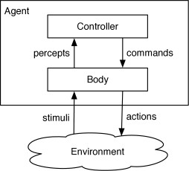
Let’s Re-examine Our Agent Design
“Sensors”
“Actions”
A: Possibly: task dependent. A hierarchical design may be better.
Q: Is this monolith design sufficient?

Slide 35
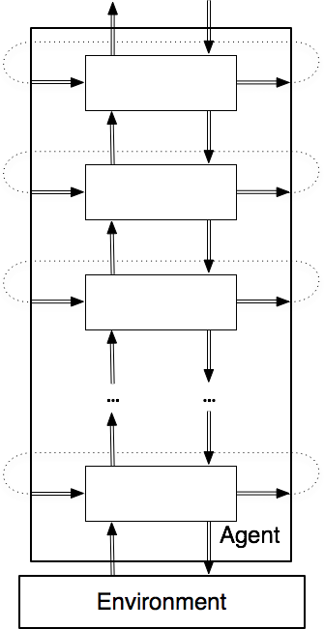
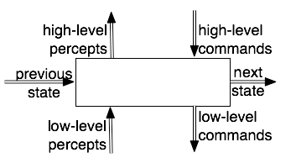
Hierarchical Design
Fig. 2.4

Slide 36
Summary
Agent programs map percepts to actions and update their internal state
Reflex agents respond immediately to percepts
Goal-based agents act to achieve their goal(s)
Utility-based agents maximize their utility function
Representing knowledge is important for good agent design
Most challenging environments are partially observable, stochastic, sequential, dynamic, and continuous and contain multiple agents
Courtesy Tim Finin

